Slide 1
Data Matrix
Aum Sri Sairam

Slide 2
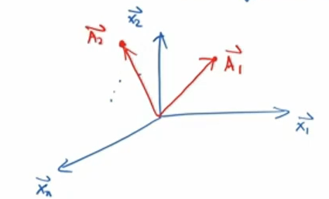
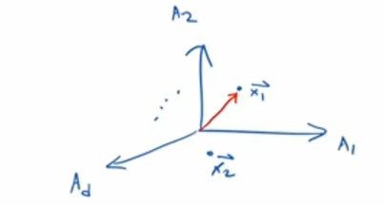
Views
Point View vs Attribute View
All vectors are assumed as column vectors
Attributes are orthogonal vectors forming the space
Point View
Attribute View

Slide 3
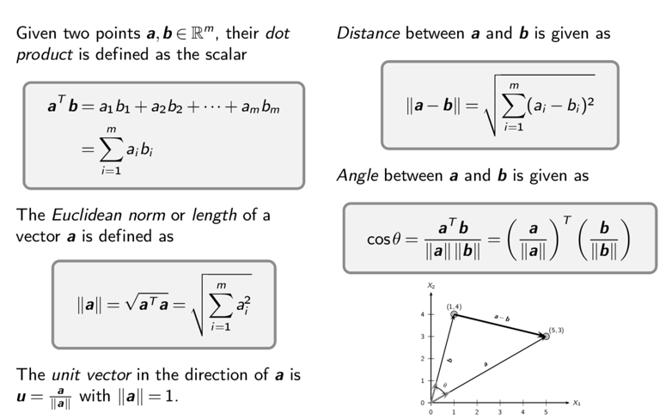
Norm Distance and Angle

Slide 4
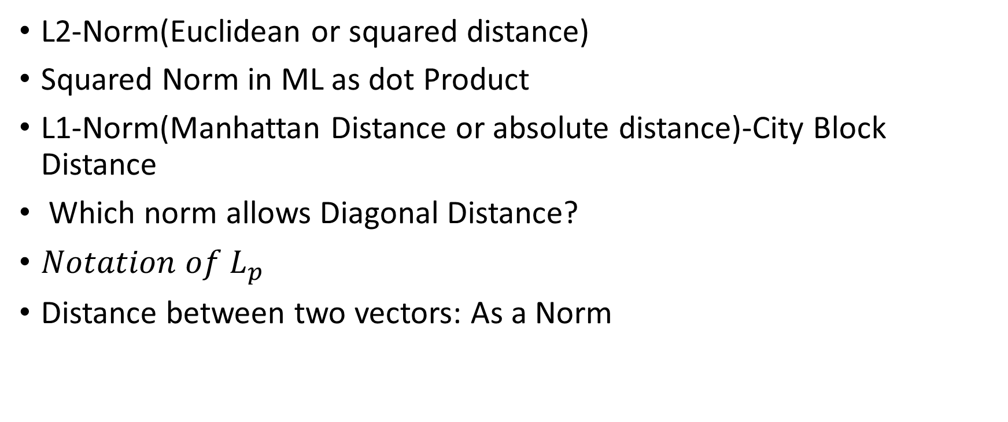

Norm/Length/Magnitude of a Vector

Slide 5
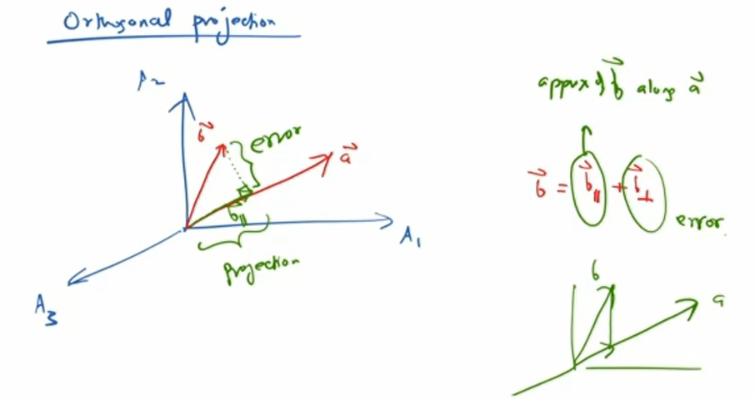
Distance between Target vector and the predicted vector

Slide 6
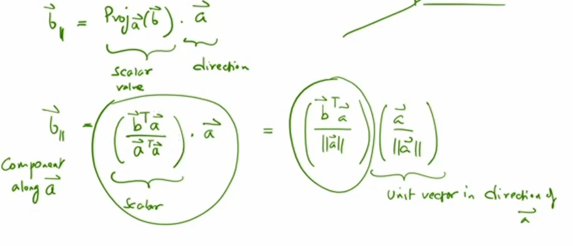

Slide 7
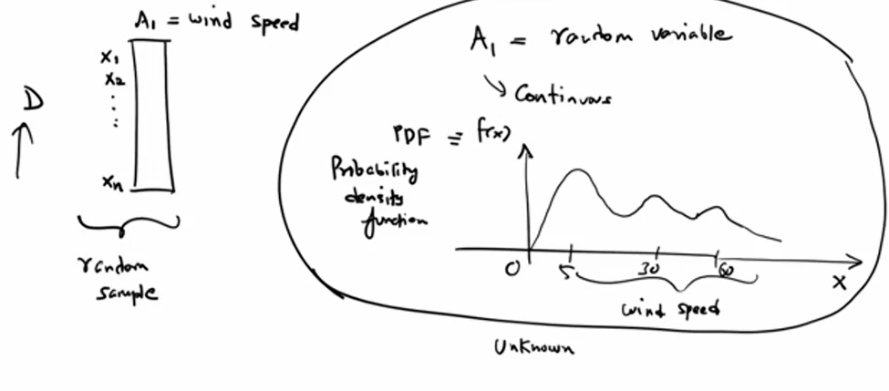
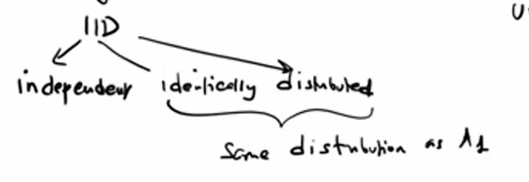

Slide 8
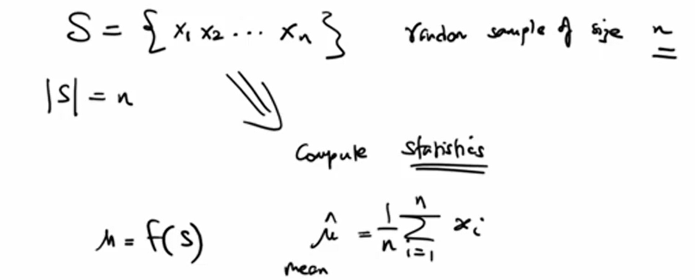
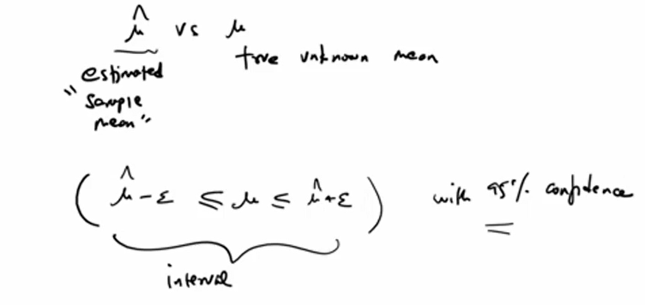

Slide 9
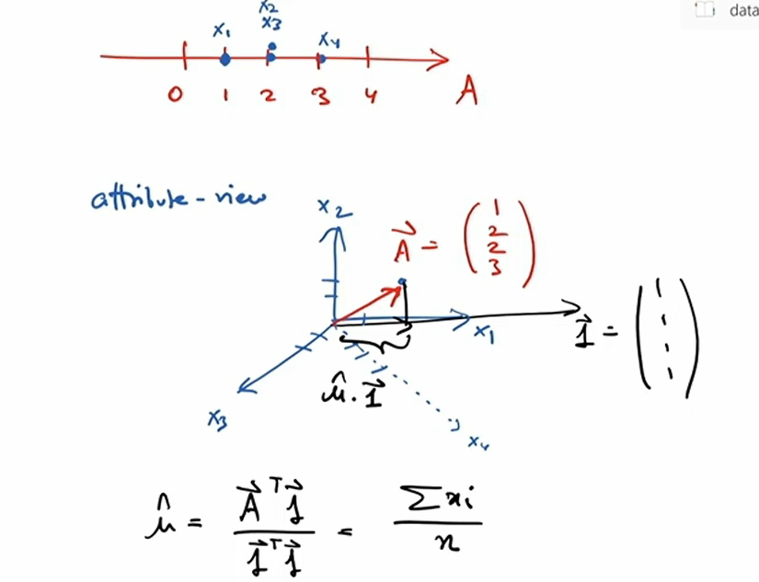
Mean

